Slide 1

The Battle of the Cities
André A. G. Barbosa
February, 2021
A Data Science project

Slide 2
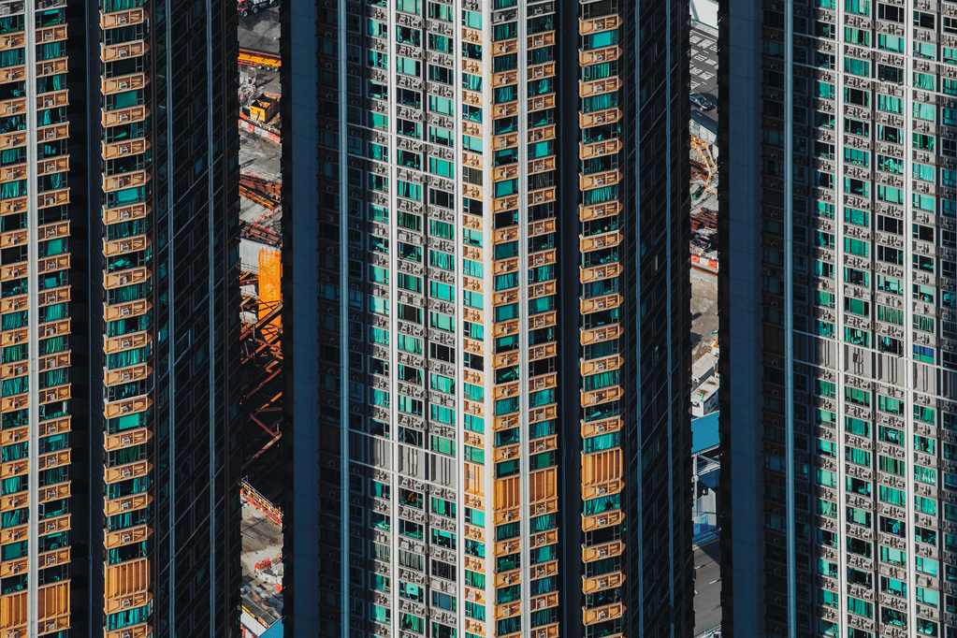
Contents
The Problem
The Data
The Analysis
The Winner
Conclusion

Slide 3

The Problem
Bustopher Jones is a extremely wealthy gentleman who wishes to live in Portugal for a while but has some peculiar requirements about the location:
Mr. Jones is afraid of the consequences of global warming, so the city must not be by the sea;
He will buy a house by the city centre and will walk everywhere so he can flaunt his designer clothes, so the city must have various restaurants, bars, etc. in a 1km radius of his house;
It must be a well-known city, as Mr. Jones doesn’t like to explain where he lives.
.

Slide 4

The data
The most valuable asset

Slide 5
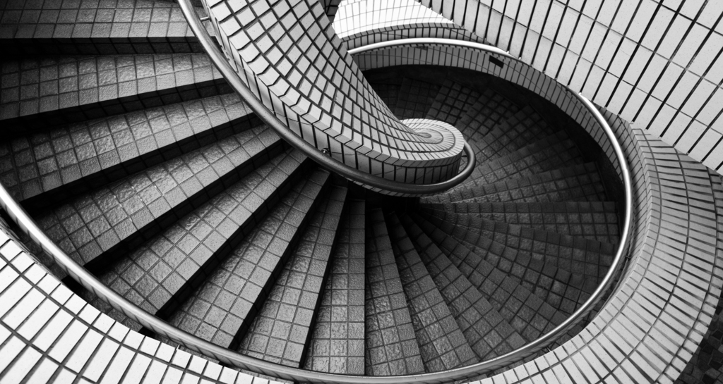
The data sources
simplemaps
Foursquare
The cities data (coordinates) came from a dataset available on https://simplemaps.com/data/pt-cities.
This dataset is the free version of their more complete dataset
The venues data comes from Foursquare, using their API.

Slide 6
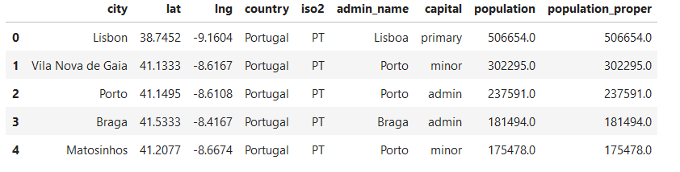
The data
The data frame head

Slide 7
The analysis
Clean the data
Cluster the data
Chose the winner
Exclude the minor cities
Exclude the cities by the sea
Remove unneeded columns from the data frame.
Use the Elbow Curve to determine the best number of clusters
Use K-means clustering to divide the country in regions
Obtain the venues of each city and perform a One Hot Encoding
Find the most common venues on each cluster
Find the most common venues of each city on the selected cluster
Choose the winner

Slide 8
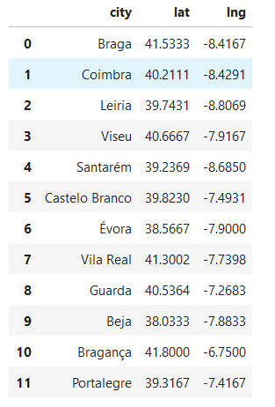
Cleaning the data
The clean data frame

Slide 9
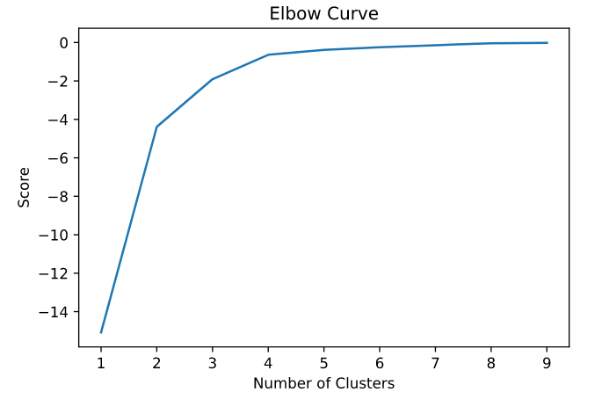
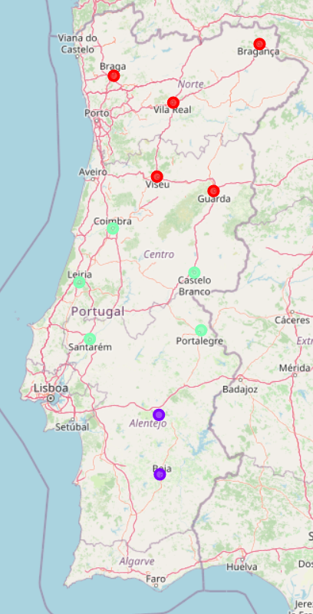
Clustering the data
The Elbow Curve
The clusters on the map

Slide 10
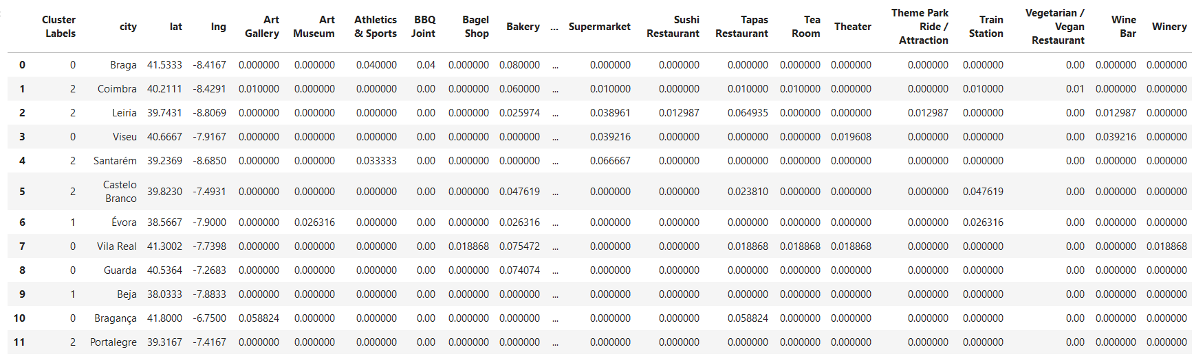
Choose the winner – One Hot Encoding
The encoded venues, grouped by city

Slide 11
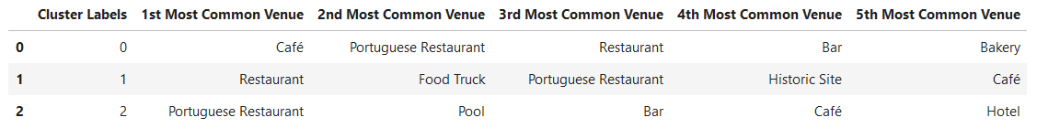
Choose the winner – The chosen Cluster
The most common venues of each cluster

Slide 12
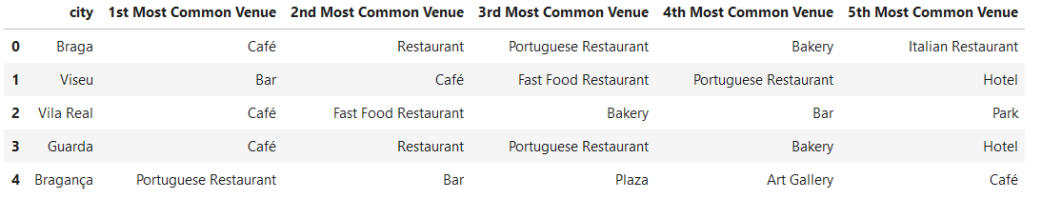
Choose the winner – The top venues per city
The most common venues of each city on the chosen cluster

Slide 13

The winner is: BRAGA as the city where the top 5 most common venues are “food places”.
Mr. Jones is a happy client.

Slide 14
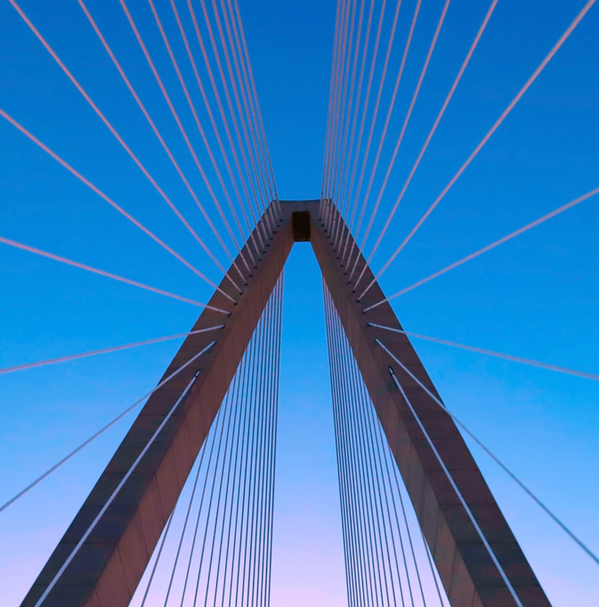
Conclusion
Based on the analysis, we can conclude that Mr. Bustopher Jones would do good in choosing the city of Braga, being far enough from the sea, well known, and with eateries being the most common venues.
If Braga is not on the taste of Mr. Jones, he can safely choose Viseu or Guarda, also well known, even further from the sea, and with eateries being also common.
André Barbosa

Slide 15





Credits
Author
André A. G. Barbosa
Data sources
All data comes from simplemaps and Foursquare.
Project link
https://github.com/Barbosabyte/battle-of-the-cities
License
This work is licensed under the Creative Commons Attribution 4.0 International License. To view a copy of this license, visit http://creativecommons.org/licenses/by/4.0/ or send a letter to Creative Commons, PO Box 1866, Mountain View, CA 94042, USA.
Disclaimer
This work was done during the Covid-19 pandemic; thus, some information may be inaccurate.

